Slide 1



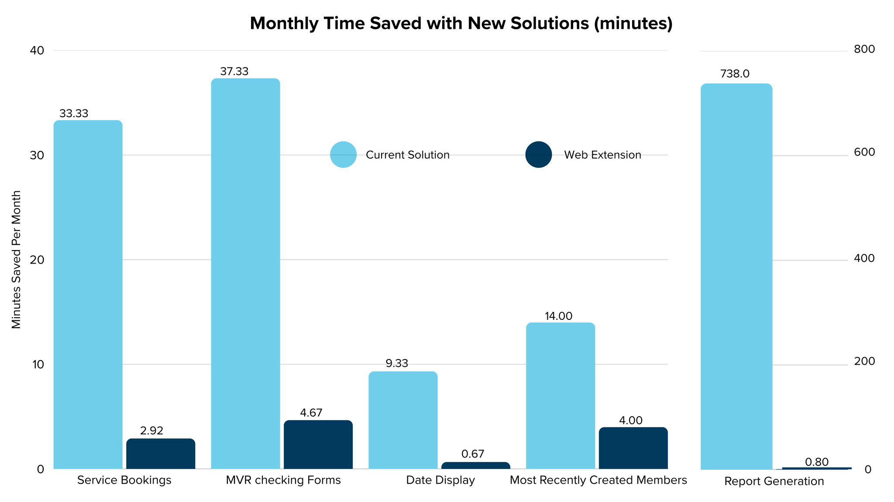
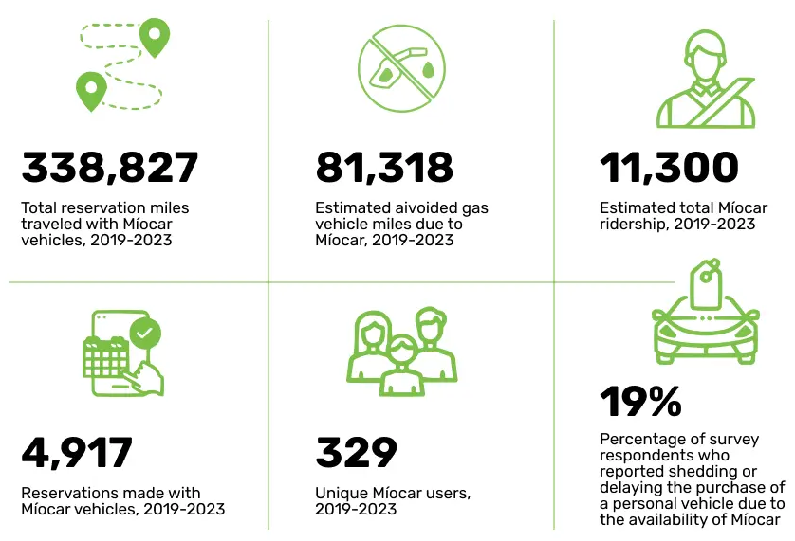
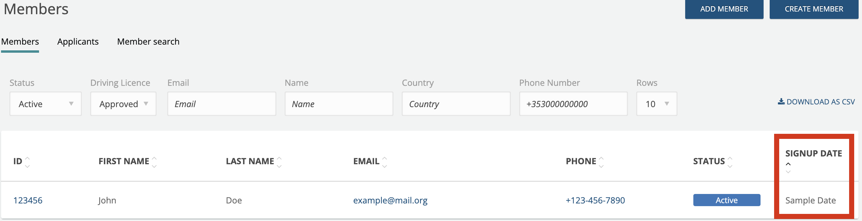
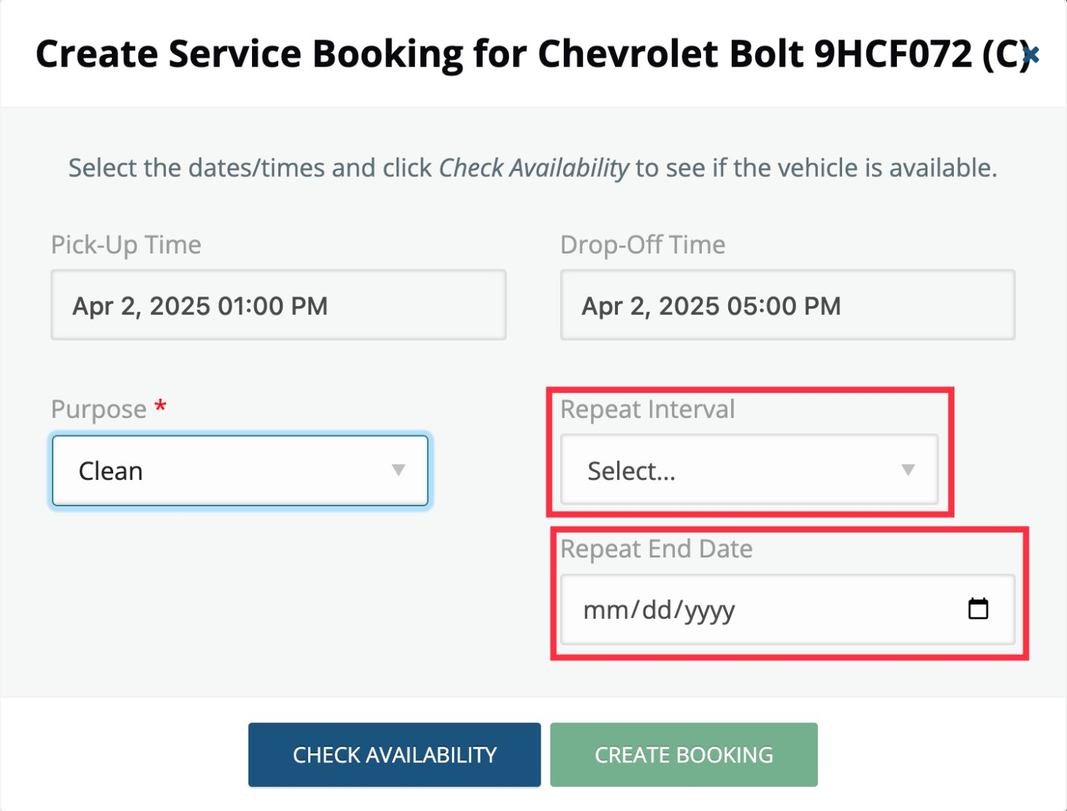
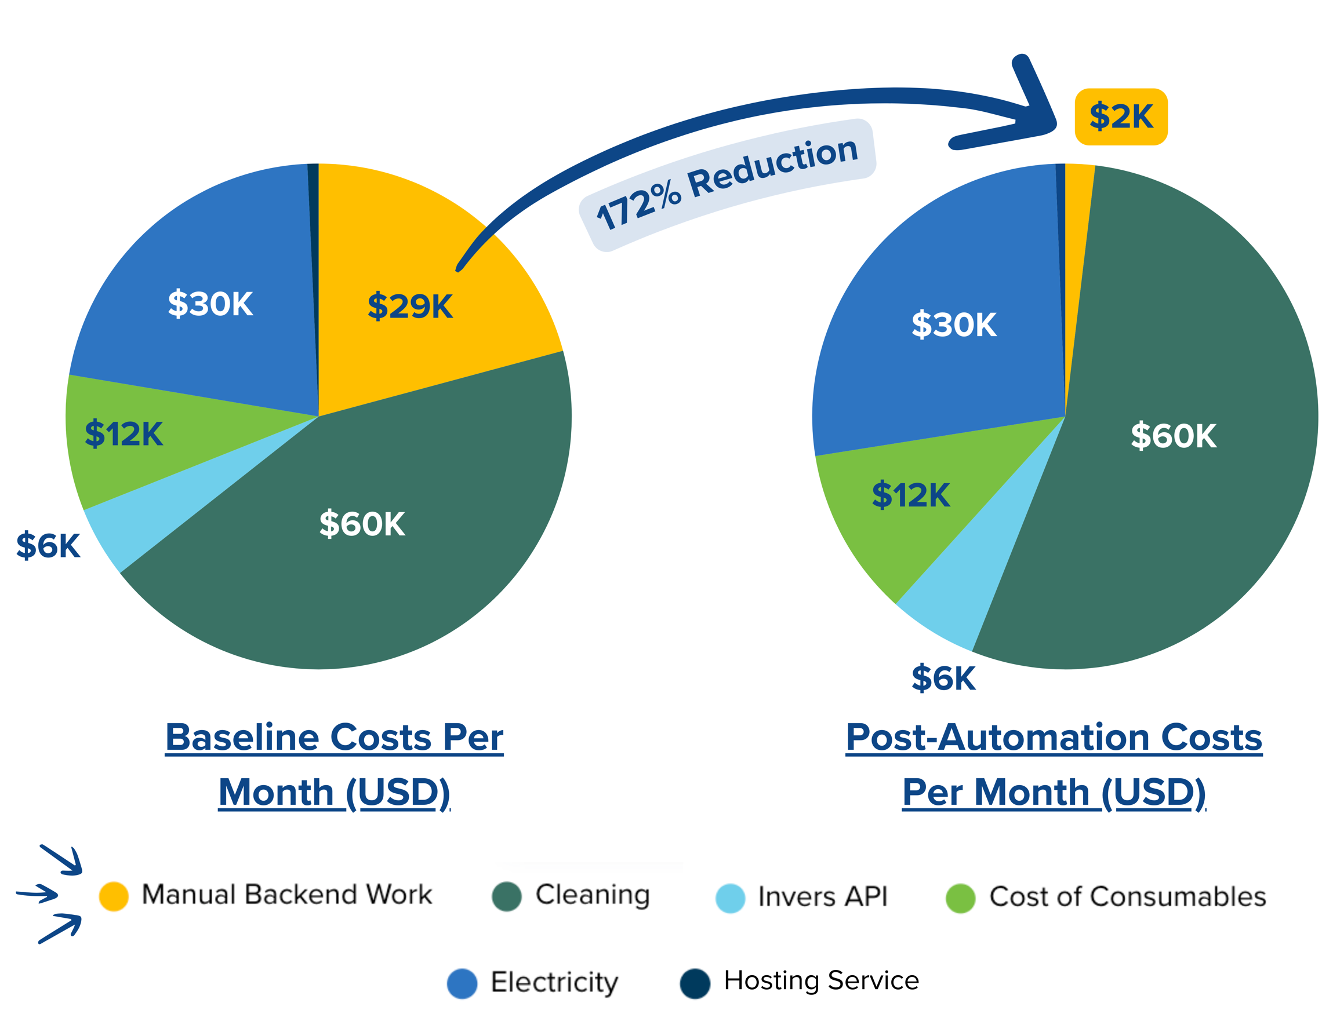
Reducing Operational Costs and Manual Labor in Shared Mobility Platforms
Harjot Gill, Kyle Gabriel Galvez, Kirat Singh, Brayan Torres
University of California, Davis
Introduction
Research Question:
What technological strategies can nonprofit organizations adopt to enhance operational effectiveness, and how do these approaches impact overall cost-efficiency?
Background and Challenges:
Míocar is a non-profit car-sharing service operating in California’s Central Valley and Bay Area.
The UCD EcoCar team aims to streamline operations and cut costs for Miocar by minimizing manual operational tasks.
Methods
Framework:
Tampermonkey is a browser extension that allows developers run custom scripts using Javascipt on web pages, modifying their default functionality and appearance.
Tampermonkey offered a balanced solution, addressing the pain points without extensive cost and time commitment of with developing a new web application from the ground up.
Github is a platform that helps teams collaborate on code, track changes, manage versions, and work together efficiently. This tool helped the team develop conflict-free in parallel.
Frontend development:
Development began with frontend integration, as our project focused on adding features to an existing website.
We prioritized user experience, ensuring the features were easy to use and seamlessly aligned with the website's existing UI
UI features were created with mock data, allowing for quick feedback. This enabled us to resolve design inconsistencies before tackling backend integration.
Conclusion
This project focused on automating key operational processes for a non-profit service, resulting in significant time savings
Non-Profits that are burdened with limited tools and technologies can lose focus on overarching goals, especially as operations scale.
This template can be used for any organization that operates on a web application-based service
Work-In-Progress
Auto-Updating:
Solutions developed will require periodic maintenance
Production scripts will be hosted on a server and will be pinged dynamically to compare running versions for changes. Updates will be pulled and merged.
Cybersecurity:
To protect sensitive API endpoints, they are hidden behind a secure server and only requested by the script when needed. Unauthorized users cannot run any script that requires backend access.
Logging and Dashboards:
Tampermonkey scripts send logs and events to a server for activity and usage tracking, which can be visualized through a dashboard/analytics application.
MongoDB will be used to store the logs and events in JSON Format.
Chatbot & AI Features:
Report text summarization can be employed to give interactive reports on business operations. Admins can gain deeper operational insight on demand.
Using the collective data available on request, admin will be able to streamline operations and gather insights by asking questions to a chatbot.
  Ex: “Did John sign up with us recently? What’s his license status?”
Figure 1: Operation data from the official Miocar site: https://miocar.org/?page_id=15270
Figure 3: Featured added to help admin view and sort members based on signup date for maintenance and usability
Backend Development:
Network inspection tools were used for finding relevant API Request parameters to replicate/enhance functionality of several processes.
API call response logic was implemented to inform users of server responses and completion of processes when necessary.
Implemented solutions were tested to ensure key functions performed as intended.
Documentation was finalized and solutions were sent to Míocar staff for further testing in real world usage.
A cost model was developed to determine the time/cost associated with operational tasks and forecast impact of potential fixes.
This model informed our decisions regarding which problems to tackle first
Preliminary results indicate that solutions may save Míocar up to $1,300 per month in labor costs.
Developing browser extension-based solutions will yield significant benefits for Míocar.
Featured added to help admin create multiple recurring service bookings at once
Results
Cost and Time Savings:
Implemented solutions are currently saving Míocar ~14 hours a month.
If the organization is scaled to 3200 users, cost of running organizational tasks are cut by 172%.
Reduced the most time-consuming task to nearly zero (manual booking data entry)
Containerized Backend (EV Center Servers )
Chatbot & AI Features
Fast API
Ollama
Metrics Dashboard
Chart.JS
MaterialUI
MongoDB
React
Tailwind CSS
Figure 2: Percentage splits per month of time spent performing organizational tasks
Auto-Updating & Sensitive Data

